Slide 1
Health Info Connect
Your Central Hub for Health
Information
By: Sandra Chelangat

Slide 2
Introduction: Problem
Healthcare providers need efficient systems to manage client information and health programs. Currently, manual or outdated systems can lead to inefficiencies, errors, and difficulties in tracking client progress.

Slide 3
Introduction: Solution
This system was developed to address the challenges healthcare providers face in managing client data. Efficiently tracking client information and program enrollments is crucial for delivering quality care. This project provides a foundation for a more comprehensive health information system.

Slide 4
Key Features
The system provides core functionalities such as client registration, program enrollment, client search, and client profile viewing. Additionally, a Client Profile API is included, allowing other systems to access this data.

Slide 5
System Architecture
The system follows a client-server architecture. The user interacts with the system through a web browser.The browser sends requests to the Python Flask backend.
The Flask backend processes the requests and interacts with the data.The Flask backend sends responses back to the browser, which displays the information to the user.

Slide 6
Key Features
Client Registration: Allows doctors to register new clients into the system.
Program Enrollment: Enables doctors to enroll clients in one or more health programs (e.g., TB, Malaria)
Client Search: Provides functionality to search for clients from a list of registered clients.

Slide 7
Key Features
Client Profile View: Displays a client's profile, including their personal information and enrolled programs.
Client Profile API: Exposes the client profile data via an API for external systems.

Slide 8
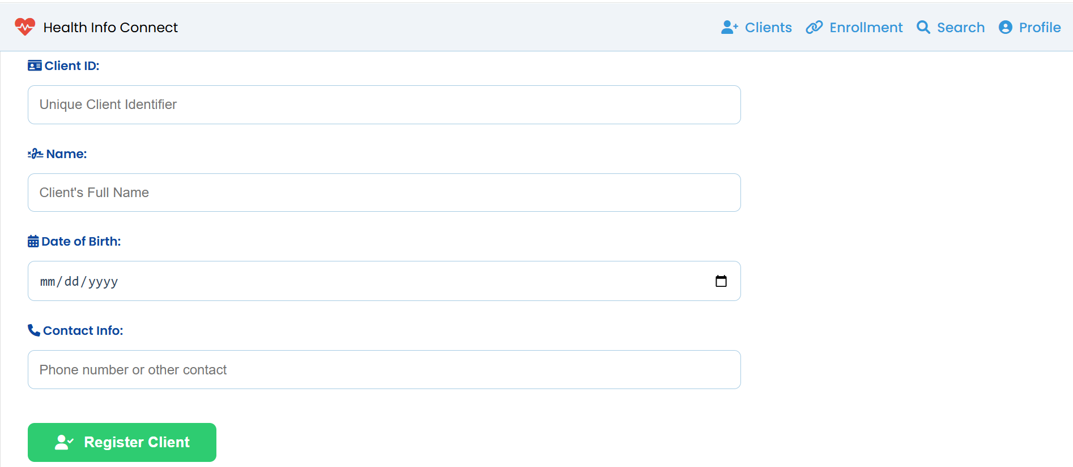
Prototype: Client Registration

Slide 9
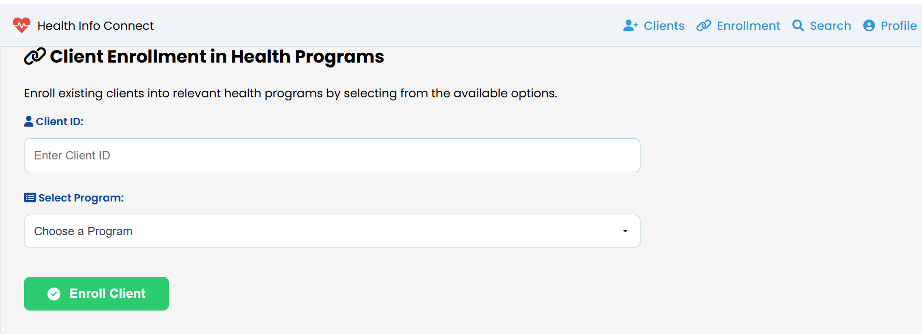
Prototype: Program Enrollment

Slide 10
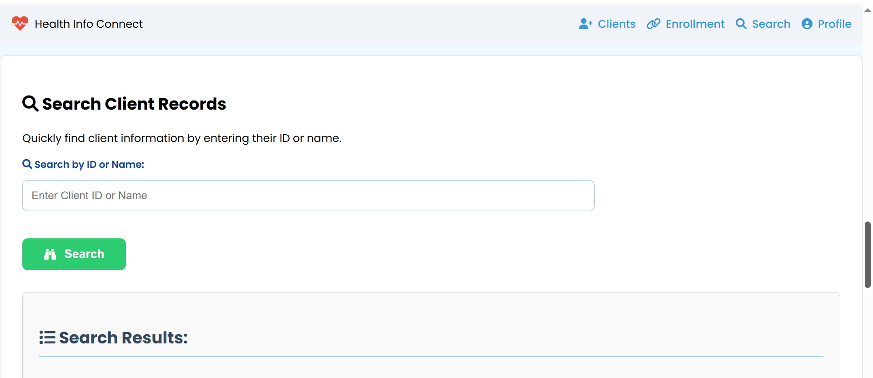
Prototype: Search Client Records

Slide 11
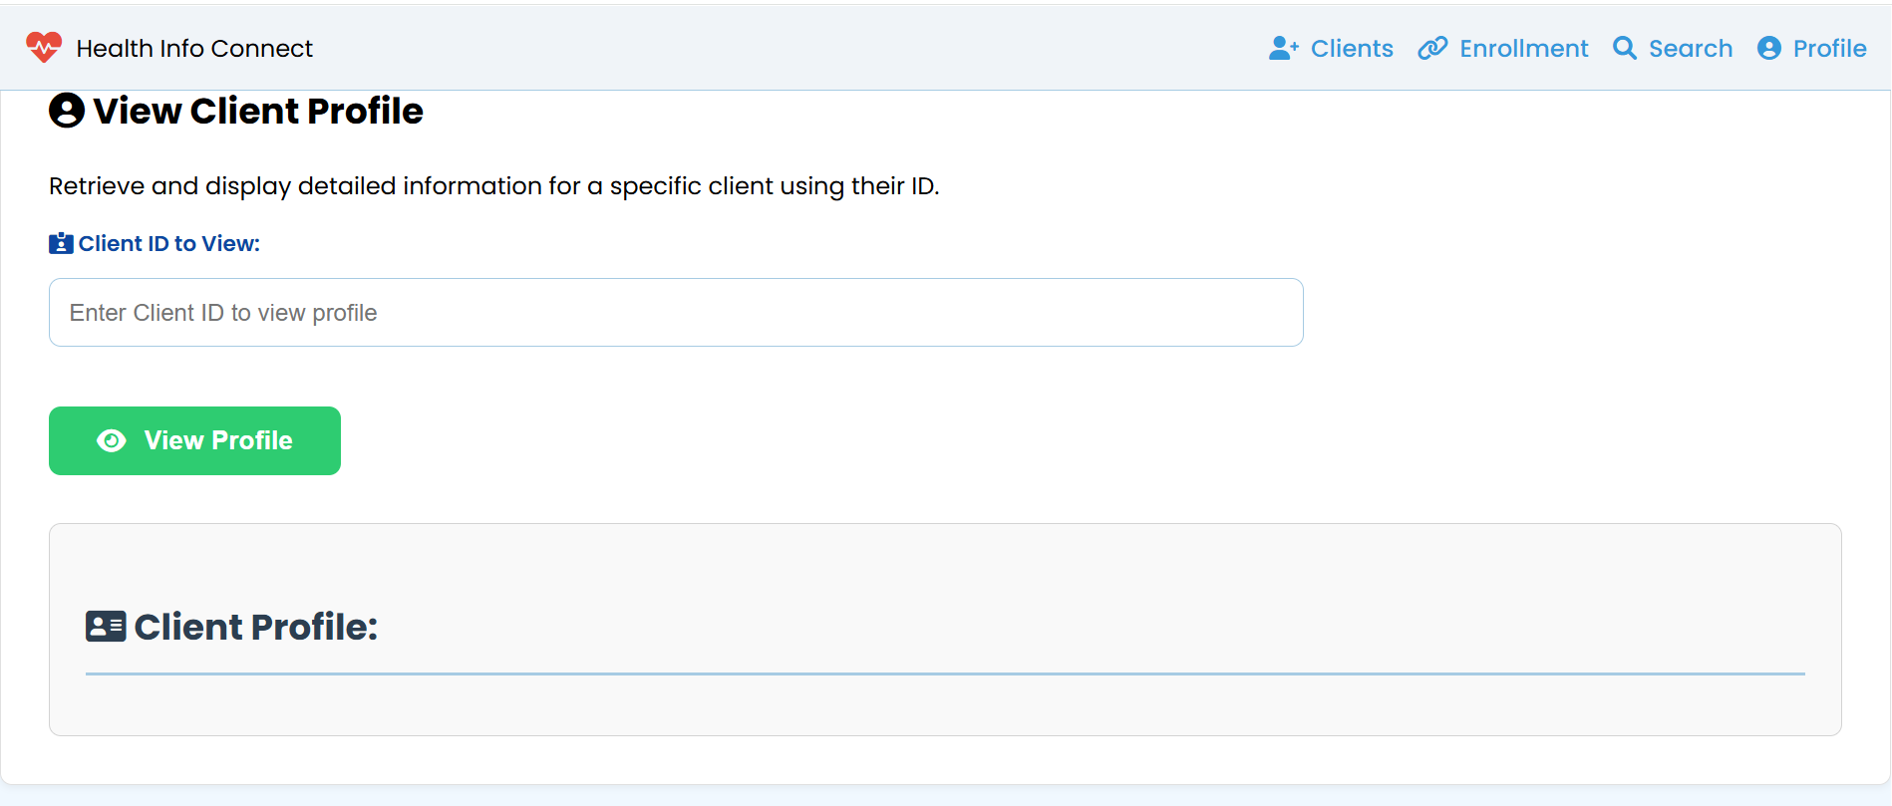
Prototype: View Client Profile

Slide 12
Client Search
The system allows doctors to search for clients by name or ID. The search_clients function returns a list of matching clients.
When a client is selected, the system retrieves their full profile using the get_client_profile function. This profile includes the client's personal information and the programs they are enrolled in.

Slide 13
Client Profile API
A key feature of this system is the Client Profile API. This API allows other systems to request and receive client data in a standardized format (JSON). The API endpoint is /api/clients/<client_id>. This promotes data sharing and integration with other healthcare systems.

Slide 14
Testing and Security
I performed manual testing to verify the functionality of the application, using this test scenario. I also implemented basic input validation.
For a real-world application, security is paramount. This would involve securing the database, implementing proper authentication and authorization, and protecting against vulnerabilities.

Slide 15
Summary
This project provides a basic but functional Health Information System that addresses the core needs of managing client data and program enrollments.
The system's features, including client registration, program enrollment, client search, client profile view, and the Client Profile API, offer a solid foundation for future development

Slide 16
Conclusion
Efficient data flow is central to the architecture. The frontend interacts seamlessly with the backend, resulting in a smooth and responsive user experience.
In short, this architecture isn't just a blueprint; it's a launchpad. Get ready to scale!

